Slide 1
Exploring AOP
COMP40040: Agent-Oriented Software
Lecturer: Rem Collier
Email: rem.collier@ucd.ie

Slide 2
Introduction
A common criticism of AOP is the steep learning curve for developers wishing to learn one of the languages.
Developers are confronted by a range of new concepts:
Mental state: beliefs, desires and intentions
Speech acts
Planning languages
These concepts seem to bear little relation to mainstream programming concepts.
This is especially true given the predominance of procedural and in particular OOP languages.
So, what can we do to reduce the gap?

Slide 3
AOP and OOP
AOP is often viewed as a specialisation of OOP, but what does this actually tell us?
OOP AOP
Basic Unit Object Agent
Parameters describing unconstrained beliefs, commitments,
state of basic unit capabilities
Process of Computation message passing and message passing and
response methods response methods
Types of Message unconstrained inform, request, offer
Constrains on Methods none honesty, consistency

Slide 4
AOP and OOP
In reality, we want such an association to answer questions like:
how does the state of an object relate to the state of an agent?
is there any correlation between how behaviours are speciﬁed in OOP and how they are speciﬁed in agents?
when and how will a behaviour be executed?
The problem is that, AOP does not promote or enforce a consistent conceptual model.
Languages like AgentSpeak(L) are event-driven
Languages like GOAL focus on action-selection.
Such diversity makes it difficult to go beyond the high-level generalisations offered by Shoham.
Instead, we must focus on particular classes of AOP language.

Slide 5
AgentSpeak(L) Revisited
AgentSpeak(L) can be prosaically described as an event-driven language:
Event handlers are ﬁred based on both a triggering event and some context.
Events – either external (environment-based) or internal (goal-based) –are generated and added to an event queue.
Events are removed from the event queue and matched to some event handler which is then fired.
The matching process checks both that the event handler applies to the event and that the handler can be executed based on the context, which deﬁnes valid program states in which the handler may be fired.

Slide 6
AgentSpeak(L) Revisited
In AgentSpeak(L) terminology:
event handlers are known as plan rules;
the program state is modeled as a set of beliefs, that are realized as atomic predicate logic formulae;
the events are also modeled as atomic predicate formulae (with some additional modiﬁers); and
the execution of plan rules is achieved through creation and manipulation of intentions.
Finally, external events are generated through changes to the agent’s state (i.e. the adoption or retraction of a belief), and internal events are generated by declaring goals.

Slide 7
AgentSpeak(L) and OOP
AOP | OOP | Motivation for mapping
Beliefs | Fields | Global state.
Plan Rules | Methods | Behaviour definition.
Goals | Method Calls | Behaviour calling.
Events | Messages | Behaviour triggering.
Intentions | Threads | Behaviour execution.

Slide 8
Beliefs as Fields
These concepts refer to state:
In OOP, state is defined in terms of a set of fields that hold values (or object references).
For example, int value; declares an integer field with name value.
Fields are, typically, given a default initial value, which in the case of an integer is 0.
In AgentSpeak(L), state is defined in terms of a set of beliefs that define relations on values.
For example, the belief value(0) declares a belief whose name is value and whose value is 0.
So, the way we define that state of an object seems to have an equivalent for beliefs…

Slide 9
Beliefs as Fields
Type | Java | AgentSpeak(L)
Primitives | double balance; int age = 42; String name = “Bob”; | balance(0.0) age(42) name(“Bob”)
Arrays | int[] array; int[] ages = {42, 8, 6} | array([]) ages([42, 8, 6])
Data Classes | class person { public String name; public int age; public char sex; } | Modelled as predicates or functional terms: person(“Rem”, 42, m) person(“Tanya”, 6, f) person(“Coral”, 8, f)
Maps | Map<String, String> parents = new HashMap<String, String>(); parents.put(“Tanya”, “Rem”); parents.put(“Coral”, “Rem”); | parents(“Tanya”, “Rem”) parents(“Coral”, “Rem”)
Sets | Set<String> lecturers = new HashSet<String>(); lecturers.add(“Henry”); lecturers.add(“Rem”); | lecturers(“Henry”) lecturers(“Rem”)

Slide 10
Beliefs as Fields
Two operations commonly associated with fields are:
Assignment: e.g. value = 5; or name = “Rem”;
Comparison: e.g. value == 3 or name.equals(“Fred”)
AgentSpeak(L) offers equivalents to these operations:
Assignment: this involves first dropping the existing belief and then adopting a new belief with the new value: -value(0); +value(5) or –name(“Bob”); +name(“Rem).
Comparison: this can be done in two places – the plan rule context or via a query statement: <tr> : name(“Fred”) <- … or ?name(“Fred”).
It is important to note that assignment is atomic in OOP languages, but is not atomic in AgentSpeak(L).
A Jason optimisation is the statement -+value(5) which has the effect of removing one belief of the form value(X) and adding the belief value(5) atomically.

Slide 11
Beliefs as Fields
Manipulating Data Classes:
A data class is an OOP equivalent of a structure – it contains only fields that hold values.
Data classes can be represented using beliefs, but:
The fields cannot be accessed by name; instead you must know the numerical position of the field in the belief.
You have to know about all the fields that exist.
Instances can only be accessed indirectly through a lookup of the belief base where the value of the field is bound to a variable.
For example, to access the name field of our person data class, you must use a query of the form: person(N, A, S).
In Jason the (“_”) operator represents any value, for example: person(N, _, _) shows you are only interested in the name.
To retrieve a specific instance, you must know enough of the fields to uniquely identify that instance.
Functional terms can also be used, but they suffer from the same problems.

Slide 12
Beliefs as Fields
The requirement to know enough information to uniquely identify an instance is what makes beliefs better suited for representing maps.
Maps hold key-value pairs, where each key is uniquely associated with a value.
Beliefs can model the association, but they do not enforce uniqueness, for example: likes(“Rem”, “beer”) and likes(“Rem”, “icecream”) can both be beliefs.
To enforce the uniqueness constraint, you actually need to write code:
+!put_parent(X, Y) : parent(X, Z) <-
-parent(X, Z);
+parent(X, Y).
+!put_parent(X, Y) <-
+parent(X, Y).

Slide 13
Beliefs as Fields
While fields can be mapped onto beliefs, one key piece of information is lost – types.
In AOP variables tend to be dynamically typed as a result of their origins in logic programming.
Types can be a powerful feature as they can be used to statically verify the correctness of code.
In OOP, a type can be used to identify scenarios where the wrong type of data is passed to a method or assigned to a field.
For developers trained using statically typed languages like C or Java, lack of typing is just one more hurdle to overcome…

Slide 14
Beliefs as Fields
In AOP, type systems can be applied at two levels:
The Multi-Agent Level: the association of types with agent instances.
Benefits include support for code reuse and run-time substitution of agent instances.
The Language Level: the application of types to the terms of logical formulae.
Benefits include improved readability and static type checking.
Static typing requires the definition of correct forms for beliefs, actions and goals (e.g. !print(string)).
This could be extended further to provide typing for environment percepts and actions…

Slide 15
Plan Rules as Methods
These concepts refer to the definition of behaviours:
In OOP, behaviour is defined by methods.
In AgentSpeak(L), behaviour is defined by plan rules.
Both forms are essentially labelled blocks of procedural code that can be executed on demand.
In OOP, a method is executed whenever the method signature is matched to a message that has been received by the object.
In AgentSpeak(L), a plan rule is executed whenever an event matching the triggering event of the rule is processed and the rules context is satisfied.
In this sense, a triggering event is synonymous with a method signature (they are the patterns that the event/message is matched against).
While there is no equivalent for context, it can be viewed as a form of method overloading based on state.

Slide 16
Plan Rules as Methods
An assumption:
If algorithms are a typical way for defining behaviour in OOP and methods are the common mechanism for implementing algorithms, would it not be natural for somebody learning AgentSpeak(L) to attempt to implement some established algorithms using the language?
For example, what about the selection sort algorithm?

Slide 17
Plan Rules as Methods
Algorithm SelectionSort(A, n):
for j = 1 to n-1 do
minIndex = j
for k = j+1 to n-1 do
if (A[minIndex] < A[k]) then
minIndex = k
if (minIndex <> j) then
temp = A[j]
A[j] = A[j+1]
A[j+1] = temp
return A

Slide 18
Plan Rules as Methods
!do_sort([7, 5, 12, 15, 3]);
+!do_sort(L) <-
_size(L, S);
!outerLoop(L, S, 0);
?sorted(L2);
_print(L2).
+!outerLoop(L, S, X) <-
+min_index(X);
!innerLoop(L, S, X);
?min_index(Z);
-min_index(Z);
!update(L, S, X, Z).
+!update(L, S, X, Z) : X < Z <-
_swap(L, X, Z, L2);
!outerLoop(L2, S, X+1).
+!update(L, S, X, Z) <-
!outerLoop(L, S, X+1).
+!outerLoop(L, S, X) <-
+sorted(L).
+!innerLoop(L, S, X) : X < S <-
_elementAt(L, X, T);
!compare(L, X, T);
!innerLoop(L, S, X+1).
+!innerLoop(L, S, X) <-
_skip().
+!compare(L,X,T):min_index(Y)<-
_elementAt(L, Y, S);
!compare(L, X, Y, S, T).
+!compare(L, X, Y, S, T) : S < T <-
-min_index(Y);
+min_index(X).
+!compare(L, X, Y, S, T) <-
_skip()

Slide 19
Plan Rules as Methods
Increased Complexity: the AgentSpeak(L) code is 3 times as long as the pseudo code.
This does not include the code for the 5 primitive actions: _size(...), _elementAt(...), _swap(...), _print(...), and _skip().
This can result in loss of readability…
Rule Explosion: one method has been mapped to 9 rules
2 rules are required to implement an if statement or a loop:
if – one rule for the positive branch and one rule for the negative branch.
for – one loop for the continuation of the loop and one rule to terminate the loop.
Both rules are required in all cases – even when they do nothing…

Slide 20
Plan Rules as Methods
Return Values: sub-goal calls do not return values.
Instead, the value must be stored as a belief (in global state).
Upon completion of the sub-goal a separate query statement must be used to retrieve the return value from the beliefs.
The result is that goal invocation and returning of values is decoupled and not obvious (how do you know how what return values exist and how they are generated).
+!start <-
!set_text(“hello”, “world”);
?the_text(X);
print(X).
+!set_text(X, Y) <-
+the_text(X+” “+ Y).

Slide 21
Intentions as Threads
At a high level, intentions represent the agents efforts at achieving its goals.
An agent creates a new intention for every external event that it matches to a plan rule.
An intention is basically an execution stack that contains each action that must be performed.
The next action to be performed sits on top of the stack.
An execution step involves removing the top item from the stack and executing it.
This can lead to additional actions being added to the stack (via sub goals).
In situations where an agent has multiple intentions, the accepted view is that intention execution is interleaved.
On each iteration, one intention is selected an executed.

Slide 22
Intentions as Threads
!init(1).
!init(2).
+!init(X) <-
print(X + “A”);
print(X + “B”);
print(X + “C”).
!init(1)
!init(2)

Slide 23
Intentions as Threads
!init(1).
!init(2).
+!init(X) <-
print(X + “A”);
print(X + “B”);
print(X + “C”).
print(1+”A”)
print(1+”B”)
print(1+”C”)
!init(1)
!init(2)

Slide 24
Intentions as Threads
!init(1).
!init(2).
+!init(X) <-
print(X + “A”);
print(X + “B”);
print(X + “C”).
print(1+”A”)
print(1+”B”)
print(1+”C”)
!init(1)
print(2+”A”)
print(2+”B”)
print(2+”C”)
!init(2)

Slide 25
Intentions as Threads
!init(1).
!init(2).
+!init(X) <-
print(X + “A”);
print(X + “B”);
print(X + “C”).
Output:
1A
print(1+”A”)
print(1+”B”)
print(1+”C”)
!init(1)
print(2+”A”)
print(2+”B”)
print(2+”C”)
!init(2)

Slide 26
Intentions as Threads
!init(1).
!init(2).
+!init(X) <-
print(X + “A”);
print(X + “B”);
print(X + “C”).
Output:
1A
2A
print(1+”B”)
print(1+”C”)
!init(1)
print(2+”A”)
print(2+”B”)
print(2+”C”)
!init(2)

Slide 27
Intentions as Threads
!init(1).
!init(2).
+!init(X) <-
print(X + “A”);
print(X + “B”);
print(X + “C”).
Output:
1A
2A
1B
print(1+”B”)
print(1+”C”)
!init(1)
print(2+”B”)
print(2+”C”)
!init(2)

Slide 28
Intentions as Threads
!init(1).
!init(2).
+!init(X) <-
print(X + “A”);
print(X + “B”);
print(X + “C”).
Output:
1A
2A
1B
2B
print(1+”C”)
!init(1)
print(2+”B”)
print(2+”C”)
!init(2)

Slide 29
Intentions as Threads
!init(1).
!init(2).
+!init(X) <-
print(X + “A”);
print(X + “B”);
print(X + “C”).
Output:
1A
2A
1B
2B
1C
print(1+”C”)
!init(1)
print(2+”C”)
!init(2)

Slide 30
Intentions as Threads
!init(1).
!init(2).
+!init(X) <-
print(X + “A”);
print(X + “B”);
print(X + “C”).
Output:
1A
2A
1B
2B
1C
2C
!init(1)
print(2+”C”)
!init(2)

Slide 31
Intentions as Threads
!init(1).
!init(2).
+!init(X) <-
print(X + “A”);
print(X + “B”);
print(X + “C”).
Output:
1A
2A
1B
2B
1C
2C
!init(1)
!init(2)

Slide 32
Intentions as Threads
!init(1).
!init(2).
+!init(X) <-
print(X + “A”);
print(X + “B”);
print(X + “C”).
Output:
1A
2A
1B
2B
1C
2C
!init(2)

Slide 33
Intentions as Threads
!init(1).
!init(2).
+!init(X) <-
print(X + “A”);
print(X + “B”);
print(X + “C”).
Output:
1A
2A
1B
2B
1C
2C

Slide 34
Intentions as Threads
Clearly - intentions operate in a similar way to threads.
In fact, intentions can be seen as “fairer” because they yield after each atomic operation is executed.
But does AgentSpeak(L) reflect this? NO!
No return values = use of global state to store returned value
What would happen if we tried to sort 2 lists concurrently?
Consider 2 intentions A and B.
On iteration i, intention A stores the sorted list in the global state.
On iteration i+1, B stores its sorted list in the global state.
Two iterations later, which list does A retrieve?
In cases where a query with variables matches more than one belief, the query is considered ambiguous and the variable can be bound to either value…

Slide 35
Plan Rules as Methods
Solution 1: Introduce support for mutual exclusion.
Declare a rule as atomic, forcing the interpreter to execute the resulting intention completely.
Solution 2: Allow goals to return values
Allow unbound variables to be passed to goals.
The variable is bound to a value in the selected plan rule.
NOTE: Jason supports both 1 and 2.
Unbound variables can be passed via a goal.
But, you still need to know which parameters should be bound and should be unbound…
What happens if you pass a bound variable instead of an unbound variable?
Rules can be declared as atomic, giving the resultant intention priority over all other intentions.
This can only be done at the rule level.

Slide 36
Plan Rules as Methods
the_text("hello world.").
!start.
+!start : true <- !get_text(X); .print(X).
+!get_text(X) <- ?the_text(X).

Slide 37
Plan Rules as Methods
There are some limitations:
Atomic rules promote rule explosion.
Each critical section must be encapsulated in a rule.
This can reduce readability.
A single global critical section exists.
Entering a critical section locks access to all other critical sections, even if the code is unrelated.
What if an agent uses multiple resources concurrently?
Why not introduce the idea of atomic blocks (of code)?
Some form of token could be used to associate related critical sections.

Slide 38
Plan Rules as Methods
Sketch of a while loop in Jason:
+event : context <-
....
+vl(20);
while (vl(X) & X > 10) { //where vl(X) is a belief
.print("value > 10");
-+vl(X-1);
}
....
What is wrong with this?

Slide 39
Events as Messages
Can seem contentious:
Messages are used for speech-act based interaction.
Shoham said message passing was the same in AOP and OOP.
This is not wrong, but…
Shoham’s view implies that only interaction drives behaviour; but what about the environment.
Interaction is not a core feature of AgentSpeak(L); however it can be (and has been) tacked on to it:
The receipt of messages is mapped to the adoption of goals.
Default semantics are provided for the handling of these goals.
From an OOP perspective, an object receives a message, and then invokes a method by matching the message to a method signature; searching up the inheritance tree as necessary.
In AgentSpeak(L) it is the event that is matched!

Slide 40
Events and Messages
So, if an event is like a message in OOP, what is an AOP message equivalent to?
Basically, an AOP message is something that can be send by or received from an agent.
Sending of messages can be modelled through actions, but how to model the receipt of messages?
The natural approach is to view it as an event!
But, what type of event?
Argument 1: Messages as beliefs…
Messages come from agents situated in the environment which is modelled using beliefs…
Nice in theory, but in practice we get an ever growing set of message beliefs…

Slide 41
Events and Messages
So, if an event is like a message in OOP, what is an AOP message equivalent to?
Basically, an AOP message is something that can be send by or received from an agent.
Sending of messages can be modelled through actions, but how to model the receipt of messages?
The natural approach is to view it as an event!
But, what type of event?
Argument 2: Messages as goals…
Messages drive behaviour (you write code to handle the message) , just like goals.
Goals are transitory: AgentSpeak(L) doesn’t maintain an explicit list of active goals.
This is what Jason does…

Slide 42
Events and Messages
So, if an event is like a message in OOP, what is an AOP message equivalent to?
Basically, an AOP message is something that can be send by or received from an agent.
Sending of messages can be modelled through actions, but how to model the receipt of messages?
The natural approach is to view it as an event!
But, what type of event?
Argument 3: Why are we using beliefs and goals anyway?
Receipt of a message can be modelled as an event.
Why not introduce a new event type?

Slide 43
Summary
What have we learnt?
AgentSpeak(L) is not suited to implementing (even simple) algorithms.
Code suffers from rule explosion leading to loss of readability.
Lack of support for return values needlessly complicates code.
We need an expanded suite of statement types. (if, while, …)
Lack of assignment and local variables are a major deficiency.
Support for mutual exclusion is a must given the similarities between intentions and threads.
Additional event types are needed to support messaging (and possibly other extensions to the basic language).
Lack of a type system makes the paradigm more difficult to learn.

Slide 44
ASTRA: AgentSpeak(L) with Bells and Whistles!

Slide 45
Introduction to Astra
The AgentSpeak(TR) Agent (ASTRA) Language is an attempt to address some of the shortcomings highlighted on the previous slide.
Specifically, ASTRA:
supports typed variables
includes support for local variables and assignment
provides and extended suite of statement types
allows return values (like Jason)
supports multiple critical areas
introduces additional event types
provides a cleaner model for defining internal actions
engenders multiple inheritance based reuse through a multi-agent level type system
adopts Java syntactic sugar to promote familiarity

Slide 46
ASTRA Language
ASTRA is designed to be close in syntax to Java:
ASTRA programs are written in files with a “.astra” extension.
Each file must contain exactly 1 agent class, which is specified by the agent keyword…
The name of the file must match the name of the class
Example File: MyAgent.astra
/**
* This is an ASTRA agent class – comments as Java
*/
agent MyAgent {
// … code goes here …
}

Slide 47
ASTRA Language: Initial States
Initial beliefs and goals can be specified using the initial keyword.
Example File: MyAgent.astra
/**
* This is an ASTRA agent class – comments as Java
*/
agent MyAgent {
initial state(“alive”); // “alive” is a string constant
initial !init();
// … code goes here …
}

Slide 48
ASTRA Language: Rules I
We can make the agent do something by writing plan rules that map events to plans.
Remember in AgentSpeak, the addition or removal of beliefs / goals result in the generation of events…
Example File: MyAgent.astra
/**
* This is an ASTRA agent class – comments as Java
*/
agent MyAgent {
initial state(“alive”); // “alive” is a string constant
initial !init();
rule +!init() {
// do something
}
}

Slide 49
ASTRA Language: Rules II
To perform a primitive action, you must declare a module.
The astra.lang.Console library provides support for printing to the console…
Example File: MyAgent.astra
agent MyAgent {
module astra.lang.Console console;
// this is the System library
initial state(“alive”); // “alive” is a string constant
initial !init();
rule +!init() {
console.println(“hello world!”);
}
}

Slide 50
ASTRA Language: Rules II
Similarly to Java, modules in the astra.lang.* package are automatically available in any agent program:
Example File: MyAgent.astra
agent MyAgent {
module Console console; // this is the System library
initial state(“alive”); // “alive” is a string constant
initial !init();
rule +!init() {
console.println(“hello world!”);
}
}

Slide 51
Running a Program
ASTRA Programs are compiled to pure Java code.
This can be done via the command line or via the ASTRA Eclipse Plugin.
The compiled code has the same name as the astra file (but with the .java extension).
In the ASTRA Eclipse Plugin, the Java source file is created in a “gen” folder not the “src” folder.
The compiler automatically adds a main method so that you can easily test your program.
Simply execute the generated Java class.
But, to make it even easier, the ASTRA Eclipse Plugin allows you to right click over the ASTRA code and run it…
ASTRA Source (.astra)
ASTRA Compiler
Java Source (.java)
Java Compiler
Java Binary (.class)

Slide 52
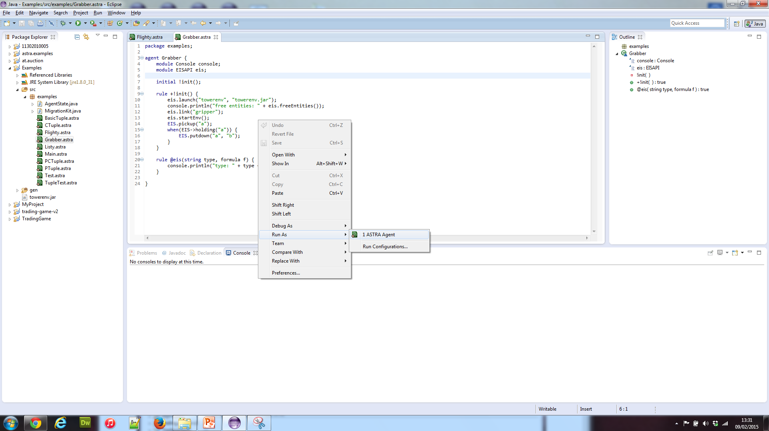
Screenshot: Running An Agent

Slide 53
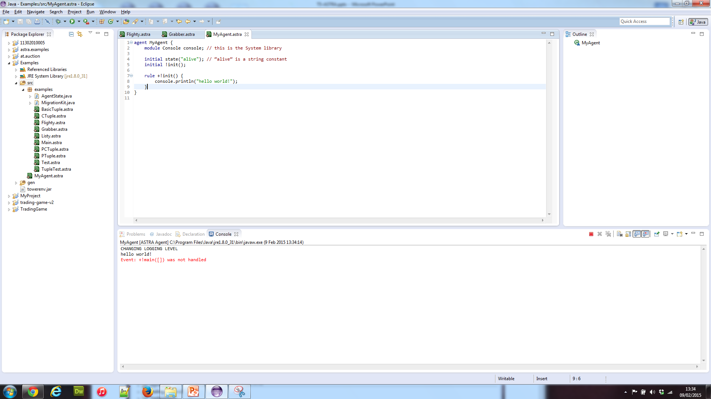
Screenshot: Example Run

Slide 54
ASTRA and Types
ASTRA is designed to be close to Java, so it adopts (most of) the Java type system:
4 and 8 byte integers (mapped to Java’s int and long types),
4 and 8 byte ﬂoating point numbers (mapped to float and double types)
representations for character and boolean values (mapped to char and boolean types).
Character strings (string) that maps to the java.lang.String class
A list type that maps to a custom implementation of the java.util.List interface.
A function type (funct) that maps to functional terms.
An object type that can be used to hold any Java object not listed above.

Slide 55
ASTRA and Internal Actions
ASTRA links the agent and Java layers through the use of modules.
A module is a java class that extends the astra.core.Module class.
Methods in the module can be annotated, exposing themselves to the agent layer in different ways:
@ACTION: these methods are internal actions. They return a Boolean value indicating the success or failure of the action.
@TERM: these methods represent basic calculations or return data from some underlying model in a form that can be represented as a term in the language (e.g. an int, float, string, list or object).
@FORMULA: these methods are constructors that return logical formula instances in ASTRA (ranging from Boolean values to logical formulae that can be matched against the beliefs of the agent).
@SENSOR: these methods generate beliefs that are added to the agents state.

Slide 56
ASTRA and Internal Actions
@ACTION, @TERM, and @FORMULA methods can be invoked explicitly from within the agent code.
@SENSOR methods are invoked through the sensing phase of the ASTRA interpreter
ASTRA checks that the types of the terms specified in the agent program match the types of arguments in the corresponding method.

Slide 57
ASTRA and Internal Actions
package ex;
import astra.core.Module;
public class MyModule
extends Module {
@TERM
public int max(int a, int b){
return Math.max(a, b);
}
@ACTION
public boolean printN(int n){
System.out.println(n);
return true;
}
}
package ex;
agent Bigger {
module MyModule m;
initial num(45, 67);
initial !init();
rule +!init() {
query(num(int X, int Y));
int n = m.max(X,Y);
m.printN(n);
}
}

Slide 58
ASTRA and Extended Plan Syntax
Core programming constructs in ASTRA include:
if statement the most basic form of ﬂow control
while loop usual method of repetition in programming
foreach loop repeats the same actions for every matching binding of a formula
try ... recover allows for the recovery from failed actions
Local variable declaration declares a variable for use within a plan rule
assignment allows the value of a local variable to be changed
Query bind the values of beliefs to variables
wait pauses execution until condition if true
when performs block of code when condition is true
send sends message to another agent
synchronized enables mutual exclusion in critical sections

Slide 59
ASTRA and Extended Plan Syntax
rule +!sort(list L, list R) {
R = L;
int j = 0;
while (j < P.size(R)) {
int min = j;
int k = j+1;
while (k < P.size(R)) {
if (P.valueAsInt(R, min) > P.valueAsInt(R, k))
min = k;
k++;
}
if (min ~= j) {
R = P.swap(R, min, j);
}
j++;
}
}

Slide 60
ASTRA and Mutual Exclusion
agent Racy {
module Console C;
initial ct(0);
initial !init(), !init();
rule +!init() {
query(ct(int X));
+ct(X+1);
-ct(X);
}
rule +ct(int X) {
C.println("X = " + X);
}
}
agent Racy {
module Console C;
initial ct(0);
initial !init(), !init();
rule +!init() {
synchronized (ct_tok) {
query(ct(int X));
+ct(X+1);
-ct(X);
}
}
rule +ct(int X) {
C.println("X = " + X);
}
}

Slide 61
ASTRA and Message Events
agent Test {
module Console C;
module System S;
rule +!main(list args) {
send(inform, S.name(), count(0));
}
rule @message(inform, string from, count(int X)) : X < 10 {
C.println("X=" + X);
send(request, S.name(), count(X+1));
}
rule @message(inform, string from, count(int X)) {
C.println("X=" + X);
C.println("STOPPED");
S.exit();
}
}

Slide 62
The “main” Event
In order to allow parameters to be passed to an ASTRA program, the +!main(list args) event is provided.
This event is generated when you run an agent.
It is only generated for the first agent that is run.
The argument is a list of strings that corresponds to the array of strings passed to the main(…) method.
This event is the preferred way to trigger the initial behaviour of the first agent that is executed.
Example File: MyAgent.astra
agent MyAgent {
module Console console; // this is the System library
rule +!main(list args) {
console.println(“hello world!”);
}
}

Slide 63
Where To Find More Info
Website: http://astralanguage.com
Cookbook (~50 example programs)
User Guide (slowly improving)
API Reference Guide (info on some of the standard modules provided)
Eclipse Update Centre: http://astralanguage.com/update

